Slide 1
Exception Handling and References in C++

Slide 2
Going to Delhi by Train
Imagine that I am going to Delhi by train today night
Train is by 9:30 pm from Central station
Approximately it takes 1:15 to reach station from VIT
When shall I leave?
I will plan to leave atleast by 7 pm
Why?

Slide 3
Going to Delhi by Train
The right travel time cannot be predicted.
There may be a delay in getting bus, traffic jam, tyre puncture, I fall down....
These are exceptions
I handle the exceptions by starting early to station

Slide 4
Exception
Unexpected situation may occur while using a software
Must be taken care during development of it
For example, if you are writing a function that retrieves a Web page, several things could go wrong. The Internet host that contains the page might be down, the page might come back blank, or the connection could be lost.
In many programming languages, you would handle this situation by returning a special value from the function, such as the NULL pointer.
Exceptions provide a much better mechanism for dealing with problems.

Slide 5

Estimate Voltage Problem
Design and implement a model of an ideal transformer. If you have a single iron core with wire1 coiled around the core N1 times and wire2 wound around the core N2 times, and if wire1 is attached to a source of alternating current, then the voltage in wire1 (the input voltage V1) is related to the voltage in wire2 (the output voltage V2) as

Slide 6
Problem
Given ‘n’ values of V₂, N₁ and N₂ compute V₁ which is given by V₂*N₁/N_{2 .} If the value of V1 is less than 230 print “less” and print “more” otherwise.
What happens if N2 is zero?

Slide 7
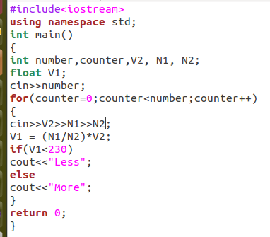

Slide 8
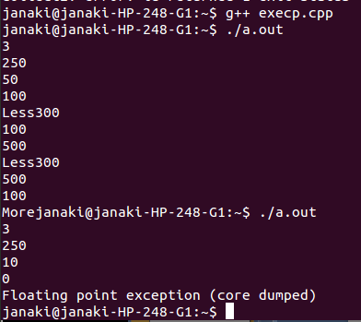
Program terminates unexpectedly
Serious problem in case of real time systems

Slide 9
Therac 25
Radiation therapy machine produced by Atomic Energy of Canada Limited (AECL) in 1982 after the Therac-6 and Therac-20 units
A real time system
Used for giving radiation therapy to cancer patients
was written in assembly language PDP 11

Slide 10
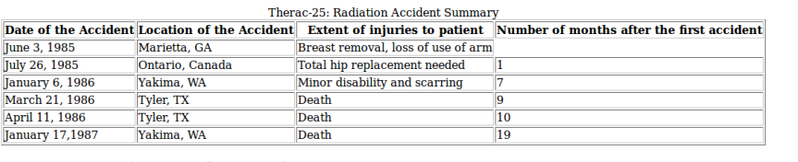

Slide 11
Why??
Failed to handle unexpected situation
Was designed with a perfect environment in mind

Slide 12
Integer Overflow
The bug that caused the second overdose at the Yakima Valley Memorial Hospital was a result of integer overflow
During the setup phase of the treatment, the program used a counter to indicate whether the inputted parameters matched the prescribed treatment.
If the parameters matched, the value of the counter was set to zero, and the treatment could proceed.

Slide 13
Integer Overflow
Otherwise, the counter was incremented.
The problem was that the counter was stored as an 8-bit integer, so it could hold a maximum value of 255.
If the counter incremented again, it would wrap around back to zero.
If the operator attempted to start the treatment at the precise time when the counter wrapped around to zero, then they could start treatment with the incorrect prescription

Slide 14
Navy Smart Ship dead in the water
USS Yorktown (DDG-48/CG-48) was a Ticonderoga-class cruiser in the United States Navy from 1984 to 2004
In 1998, Yorktown was dead in the water for about two hours and 45 minutes, fleet officials said, and did not have to be towed in.

Slide 15
Why?
Because its computers were unable to divide by the number zero
Failed to handle unexpected situation

Slide 16
Why Exception?
Compute the expression a/(b-c) repeatedly, for n times
Algorithm:
Step1: Get the input for number of times the operation has to be repeated , say n
Step2: Repeat until n less than zero
Step2: Get the input for a, b and c
Step3: Check for b and c unequality
Step4: if b and c are unequal , perform the operation a/(b-c),
Step5: else throw exception saying divide by zero and continue for next iteration

Slide 17
Exception Handling
Exception: An unwanted unexpected event that disturbs normal flow of the program is called exception.
Example: SleepingException TyrePunchuredException FileNotFoundException ...etc
It is highly recommended to handle exceptions. The main objective of exception handling is graceful (normal) termination of the program.
These type of situation can be handled by Exception handling mechanism available in C++.

Slide 18
Enter numerator (0 to stop): 18
Enter denominator1: 6
Enter denominator2: 2
Result: 4.5
Enter numerator (0 to stop): 18
Enter denominator1: 6
Enter denominator2: 6
Can't divide by zero.
Enter numerator (0 to stop): 27
Enter denominator1: 9
Enter denominator2: 6
Result: 9
Enter numerator (0 to stop): 27
Enter denominator1: 9
Enter denominator2: 9
Can't divide by zero.
Enter numerator (0 to stop): 14
Enter denominator1: 6
Enter denominator2: 4
Result: 7
Enter numerator (0 to stop): 0
Enter denominator1: 4
Enter denominator2: 2
void operation(double a, double b,double c) {
try {
if(b==c) throw b; // check for divide-by-zero
cout << "Result: " << a/(b-c) << endl; }
catch (double b) {
cout << "Can't divide by zero.\n";}
}
int main() {
double i, j,k;
do {
cout << "Enter numerator (0 to stop): ";
cin >> i;
cout << "Enter denominator1: ";
cin >> j;
cout << "Enter denominator2: ";
cin >> k;
operation(i, j,k);
} while(i != 0);
return 0;
}

Slide 19
Exception handling Mechanism
The purpose of the exception handling is to provide a mechanism to detect and report
the ‘exceptional circumstances’ in the program so that appropriate action can be taken.
This process involves separate error handling code that performs the following tasks
Identify the problem (Hit the exception)
Report that an error has occurred (Throw the exception)
Receive the error information (Catch the exception)
Take corrective actions (Handles the exception)

Slide 20
Exception Handling Model
try block
Detects and throws
an exception
Exception object
catch block
Catches and handles
an exception

Slide 21
The keyword try is used to preface a block of statements surrounded by braces which may be generating exceptions; this block of statements is known as try block
When an exception is detected, it is thrown using a throw statement in the try block
A catch block is defined by the keyword catch catches the exception thrown by the throw statement in the try block and handles it appropriately

Slide 22
Exception Handling: Format
try
{
……
throw exception; // block of statements
// which detects and
// throws an exception
}
catch (type arg) // catches exception
{
……….
………. // block of statements that
………. // handles the exception
}

Slide 23
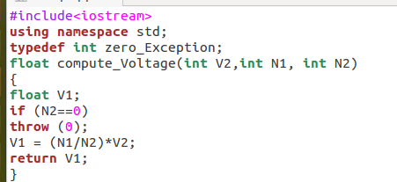

Slide 24
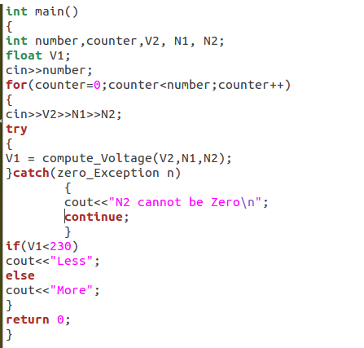

Slide 25
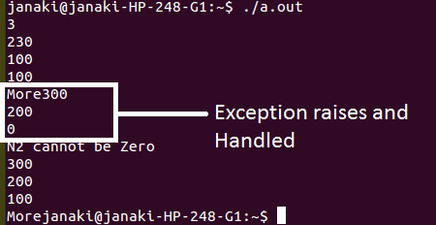

Slide 26
Throw point
Function that causes
an exception
Throw exception Invoke function
try block
invokes a function that contains an exception
catch block
Catches and handles
an exception

Slide 27
Most often, exceptions are thrown by functions that are invoked from within the try block
The point at which the throw block is executed is called the throw point
Once an exception is thrown to the catch block, control cannot return to the throw point

Slide 28
Invoking Function that Generates Exception
void divide (int x, int y, intz){
cout << " inside the function \n “;
if (( x-y) !=0)
{ int R = z/(x–y) ;
cout<< " Result = “ << R << “\n”; }
else // there is a problem
{throw (x-y);// throw point }
}
void main() {
try {cout<< ” inside the try block \n”;
divide(20,10,30); // Invoke divide
divide(30,30,60); // Invoke divide
}
catch (int i) {
cout<< “ caught the exception \n “;
}
}
inside the try block
inside the function
Result = -3
Caught the exception

Slide 29
Catching Mechanism
A catch block looks like a function definition and is of the form:
catch (type arg)
{
// statements for managing exceptions
}
The type indicates the type of exception that catch block handles.
The parameter arg is an optional parameter name; the catch
statement catches an exception whose type matches with the type
of catch argument,when it is caught, the code in the catch block is
executed.

Slide 30
Multiple Catch Statements
It is possible that a program segment has more than one condition to throw an exception; such cases, you can associate more than one catch statements with a try as shown in the following code
try
{ // try block }
catch (type1 arg)
{ // catch block1 }
catch (type2 arg)
{ // catch block2 }
……….
……….
catch (typeN arg)
{ // catch blockN }

Slide 31
void Xhandler(int test) {
try{
if(test) throw test;
else throw "Value is zero";
}
catch(int i) {
cout << "Caught Exception #: " << i;
}
catch(const char *str) {
cout << "Caught a string: ";
cout << str << '\n';
}
}
void main() {
cout << "Start\n";
Xhandler(1); Xhandler(2);
Xhandler(0); Xhandler(3);
cout << “End"; }
Start
Caught Exception #:1
Caught Exception #:2
Caught a string: Value is zero
Caught Exception #:3
End

Slide 32
Catch All Exceptions
In some situations, you may not be able to anticipate all possible type of exceptions and defining unique catch handlers to catch the appropriate one
In such situations you can force a catch statement to catch all exceptions instead of a certain type alone
For example:
catch ( …)
{
// statements for processing all exceptions
}

Slide 33
void test ( int x) {
try
{ if(x==0) throw x; //int
if(x==-1) throw ‘x’; //char
if(x==1) throw 1.0; //float
}
catch(….) // catch all
{
cout<<” caught an exception”;
}
}
void main() {
cout << “ Test for common catch “;
test(-1); test(0); test(1);
}

Slide 34
Independent Reference
Scenario: Assume you are Mr. Edwin and also you have a pet name called Buddy in your home.
When Buddy is ill, shall Edwin can take a pill to get cured. This is practically possible, even though the names are different, body is single. A body can be referred by different name.
Similarly in computer memory, basically memory locations are referred by identifier or variable name. You can create any number of reference to a memory cell. This is called independent reference or reference alias. All the reference variable you had binded point the same memory only

Slide 35
Reference Variable
A reference is an alias; when you create a reference, you initialize it with the name of another object, the target
From that moment on, the reference acts as an alternative name for the target, and anything you do to the reference is really done to the target
int &rSomeRef = someInt;
"rSomeRef is a reference to an integer that is initialized to refer to someInt

Slide 36
int main() {
int intOne;
int &rSomeRef = intOne;
intOne = 5;
cout << "intOne: " << intOne << endl;
cout << "rSomeRef: " << rSomeRef << endl;
rSomeRef = 7;
cout << "intOne: " << intOne << endl;
cout << "rSomeRef: " << rSomeRef << endl;
}
Output: intOne: 5
rSomeRef: 5
intOne: 7
rSomeRef: 7

Slide 37
Test of understanding on References
int main() {
int x = 7;
int & ref = x;
ref = 8;
int y = 10;
ref = y;
cout << “x = “ << x;
cout << “ y = “ << y;
cout << “ ref = “ << ref << endl;
}
The question is, what will this print? Stop
reading here until you know the answer.
Did you answer this way:
x = 8, y = 10, ref = 10
If so, you made the most common mistake
(don’t feel bad, it’s a trick question). Refer
again to this statement:
ref = y;
This statement did not point ref to y
instead, it was exactly as if I had written
this
x = y;
Thus, here is the correct answer:
x = 10, y = 10, ref = 10

Slide 38
One or more reference can be binded to the same variable, all reference variable refers the same target
int main() {
int a=10;
int &a1ref=a;
int &a2ref=a;
int &a3ref=a;
int &a4ref=a;
int &a5ref=a;
a1ref++; a2ref++; a3ref++; a4ref++; a5ref++;
cout<<" a is "<<a; }
a is 15

Slide 39
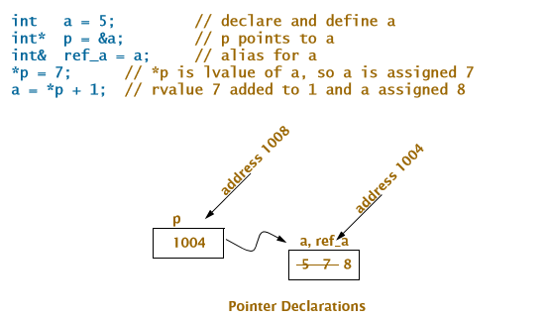
Value Reference and Address

Slide 40
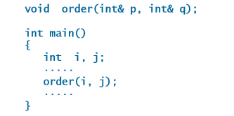
Pass by Reference

Slide 41
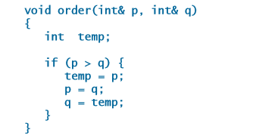
Pass by Reference

Slide 42
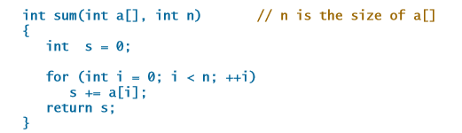
Pass by Reference

Slide 43
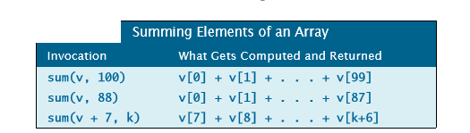
Pass by Reference

Slide 44
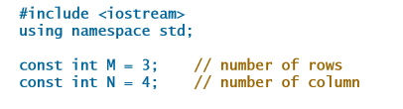
Two Dimensional More examples

Slide 45
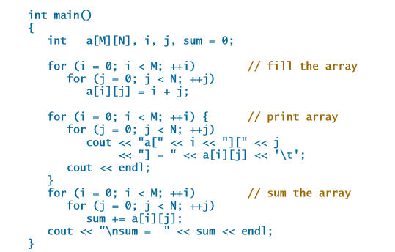
Two Dimensional More examples

Slide 46
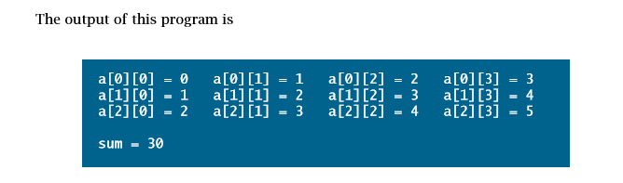

Slide 47
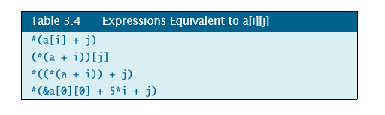

Slide 48
Passing Function Argument by Reference
Problem:
Assume that in a banking operation scenario, you are making a fund transfer operation from one account to the other of the same bank and branch. Here after transaction, the balance amount field in both the objects should be updated, i.e. debit should happen in source account and credit should happen in destination account which in turn update the balance amount field of both the objects.
To enable these type of operation successfully, both the objects involved in the above operation should be send by reference, failing which inconsistent data may prevail in the operating objects

Slide 49
Passing Function Argument by Reference
Functions has two limitations: Arguments are passed by value, and the return statement can return only one value
Passing values to a function by reference can overcome both of these limitations.
In C++, passing by reference is accomplished in two ways: using pointers and using references.
The syntax is different, but the net effect is the same.
Rather than a copy being created within the scope of the function, the actual original object is passed into the function.
Passing Function Argument by Reference is also called as returning multiple arguments

Slide 50
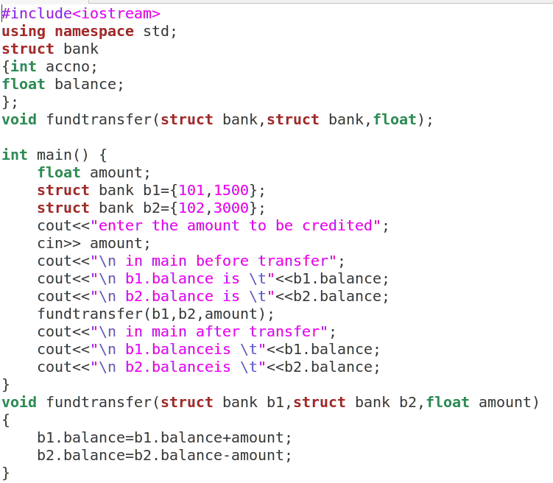

Slide 51
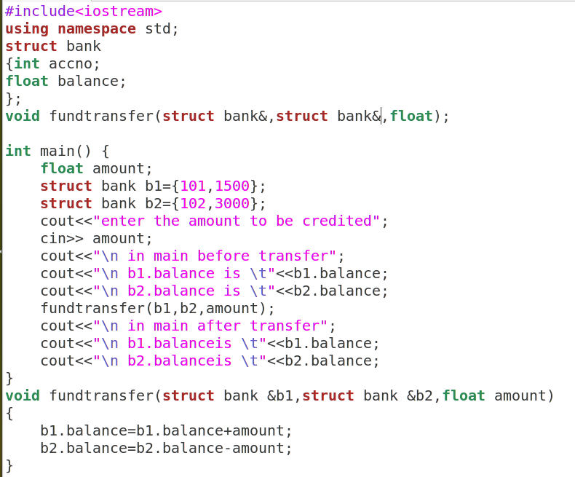

Slide 52
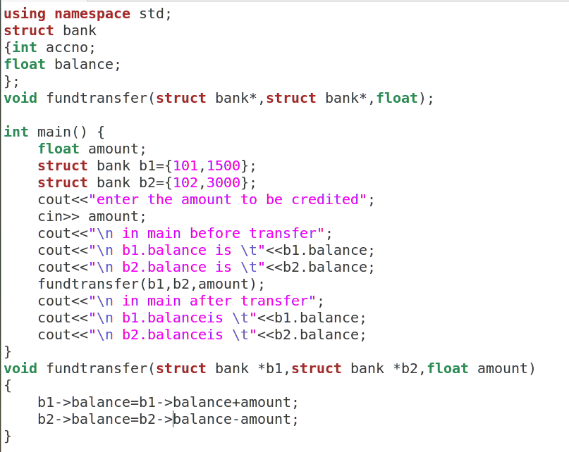

Slide 53
References are less powerful than pointers
References cannot be NULL. Pointers are often made NULL to indicate that they are not pointing to any valid thing.
A reference must be initialized when declared. There is no such restriction with pointers

Slide 54
References are safer and easier to use
Safer: Since references must be initialized, wild references like wild pointers are unlikely to exist. It is still possible to have references that don’t refer to a valid location
Easier to use: References don’t need dereferencing operator to access the value. They can be used like normal variables.
‘&’ operator is needed only at the time of declaration. Also, members of an object reference can be accessed with dot operator (‘.’), unlike pointers where arrow operator (->) is needed to access members.

Slide 55
Function Return by Reference
Scenario : Assume a function works on multiple values of a data set ( say array), it bound to return the address of one of the elements of an array after the operation. Example: say a function findmax() is expected to return the address of bigger element in a data set- array to the calling point.

Slide 56
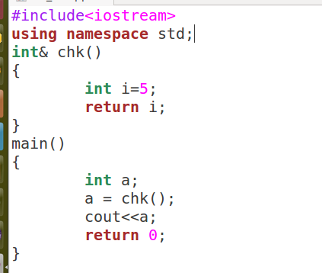
Get a warning that reference of a local variable cannot be returned

Slide 57
